Slide 1


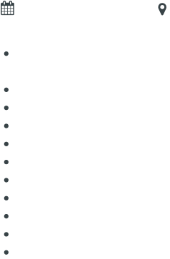
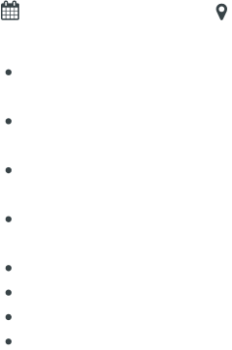
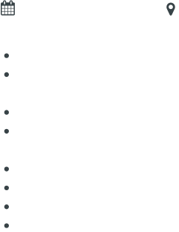
MILORAD KOSTIC
Sr. Front End Engineer
SUMMARY
9 years experienced Senior Front End Engineer with hands-on experience in identifying web-based user interactions
along with designing & implementing highly-responsive user interface components by deploying Angular concepts.
Whatever task that I set to do, I always give my best and complete it diligently well in advance.
EXPERIENCE
Sr. Front End Engineer
BJSS ( Remote )
Leeds, UK
Responsibilities:
Developed large scale web apps for MTS members and membership management with ecommerce & chat capabilities using Angular14/
TypeScript/ Sass/ Less, HTML5 /JSX.
Developed a new, white label sportsbook app, using Angular. Worked closely with the design team to implement the offer service.
Fixed performance issues by rendering real time updates from WebSockets more efficiently.
Designed and built a JavaScript request library that allows us to fetch, cache, and subscribe to data updates at each level of the offer tree.
Designed REST calls using React to streamline user interface performance.
Expert in Git as version control and Jira for defect tracking.
Performed unit testing using Karma/jasmine.
Worked with product Managers and Web Designers to implement flexible, maintainable, reusable and professional UI components.
Designed new mockups for a website layout that improved user experience and reduced bounce rate by 8%.
Collaborated with 10 senior team members to upgrade the websites of 150 customers to catch up with changing industry standards.
Collaborated with other developers to ensure code quality standards are met and followed best practices in software development.
Sr. Front End Developer
Evolink ( Hybrid )
Sofia, BG
Responsibilities:
Reviewed architecture of an Angular application that had multiple maintainability and performance problems. Identified key issues, mostly
with using wrong components and an outdated build system.
Created a prototype using Angular 1.5, Component Router, and some other suitable open-source libraries.
Integrated Formly framework with OData definitions to allow for sharing validation rules between the front end and back end.
Serve as the technical production lead, which includes adding new features and content types, writing and maintaining clean code in a best
practices environment, and making sure websites function across multiple browsers and mobile devices seamlessly.
Assisted in testing of applications by providing feedback on usability and functionality as well as identifying any defects that may exist
within an application prior to release.
Worked closely with Back-End Developers, as well as UI/UX Designers, Business Analysts, and test Engineers.
Promoted better component life-cycle practices, which increased turn around speed by 74%, an improvement from previous years.
Developed and maintained React web applications for the company’s clients, including bug fixes, enhancements, and new features.
Used React web to develop a check-in system for a local sports facility, saving them over $4,000 per year in subscription fees.
Senior Front End Developer
Teltech
Tewkesbury , UK
Responsibilities:
Developed Instaport in AngularJS as a free tool for users to download all of their Instagram media to their computer.
Created a Vibbi dashboard in AngularJS. Added an onboarding process for users to set their accounts. Managed user roles and
authentications.
Using advanced level of jQuery, AJAX, JavaScript, CSS and pure CSS layouts.
Wrote jQuery function while implementing various UI Screens across the whole web application both consumer facing as well as internal
application.
Worked as a productive and positive team member to design, code, test, report and debug operations.
Pioneered using isomorphic React.js and Node.js for 40 web applications, which decreased lead times by 69%.
Built responsive websites for 40 customers using semantic React.js compiled using maven and webpack build tools.
Built custom Report viewing Web Parts and configured the layout of the portal page to embed personalized reports from SQL Server
Reporting Services.
www.enhancv.com
Powered by

Slide 2
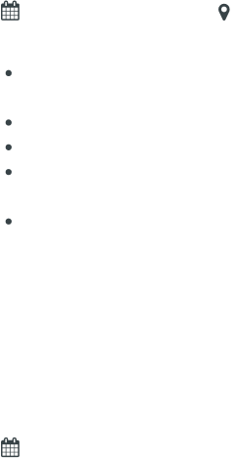

EXPERIENCE
Front End Developer
ElanWave
Novi Sad, RS
Responsibilities:
Built a front-end widget that is added as a single external script to an HTML page but works as a big library using Vanilla JavaScript and
jQuery.
Helped to achieve a consistent look and visual theme across the website by promoting uniform fonts, formatting, images and layout.
Developed my teamwork skills by working in close collaboration with 10 other colleague.
Worked on internal services with the design team, and manage time across multiple projects and tasks in a deadline-driven, team
environment.
Worked with UX designers, developers, product managers to develop a new membership platform that brought in a 37% increase in annual
revenue.
EDUCATION
Bachelor of Science
Union University
SKILLS
Angular/Angular.js
Next.js
Node.js
Rust.js
Vue.js
HTML5
CSS/CSS3/Tailwind
JavaScript/TypeScript
Redux
Bootstrap
MySQL
MOngoDB
Docker
jQuery
Python
SDLC/Agile Methodology
AWS//Azure DevOps/GCP
Git/GitHub/GitLab/Bitbucket
Slack/Jira/Kanban Board
Jest, Enzyme, Mocha, Chai
SSR/CSR
Ability to Multitask
Communication
Teamwork
Effective Time Management
www.enhancv.com
Powered by

